Slide 1
WORLD HAPPINESS REPORT
SUBMITTED BY - SANYA DUBEY

Slide 2
DATA SOURCE
THE DATA IS GATHERED FROM KAGGLE.
LINK TO THE DASHBOARD : https://public.tableau.com/app/profile/sanya.dubey/viz/WorldHappinessReport_16401939351110/Dashboard2?publish=yes

Slide 3
EXECUTIVE SUMMARY
The World Happiness Report is a landmark of the state of the global happiness.
The happiness scores and the rankin use data from the Gallup World Poll and the scores are based on the answers to the main life evaluation questions asked in the poll.
The Analysis is done from the year 2015 - 2021 Having total 139 records per year.

Slide 4
PROBLEM STATEMENT
1. Trend of Average Happiness Score by Year
2. Top 5 and Bottom Happiest Countries
3. Trend of Average Happiness Score by Region
4. Dual - Axis map Showing the regions and Countries with respective Happiness Score
6. Top 5 Countries per Year
7. Top 3 Regions per Year
8. Relationship of happiness Score with different factors involved to calculate the
happiness score.
9. Relationship of Economy of Country by Life Expectancy.
10. Percent Change in the happiness Score using heatmap
11. Relationship of factors with Happiness Score by Region

Slide 5
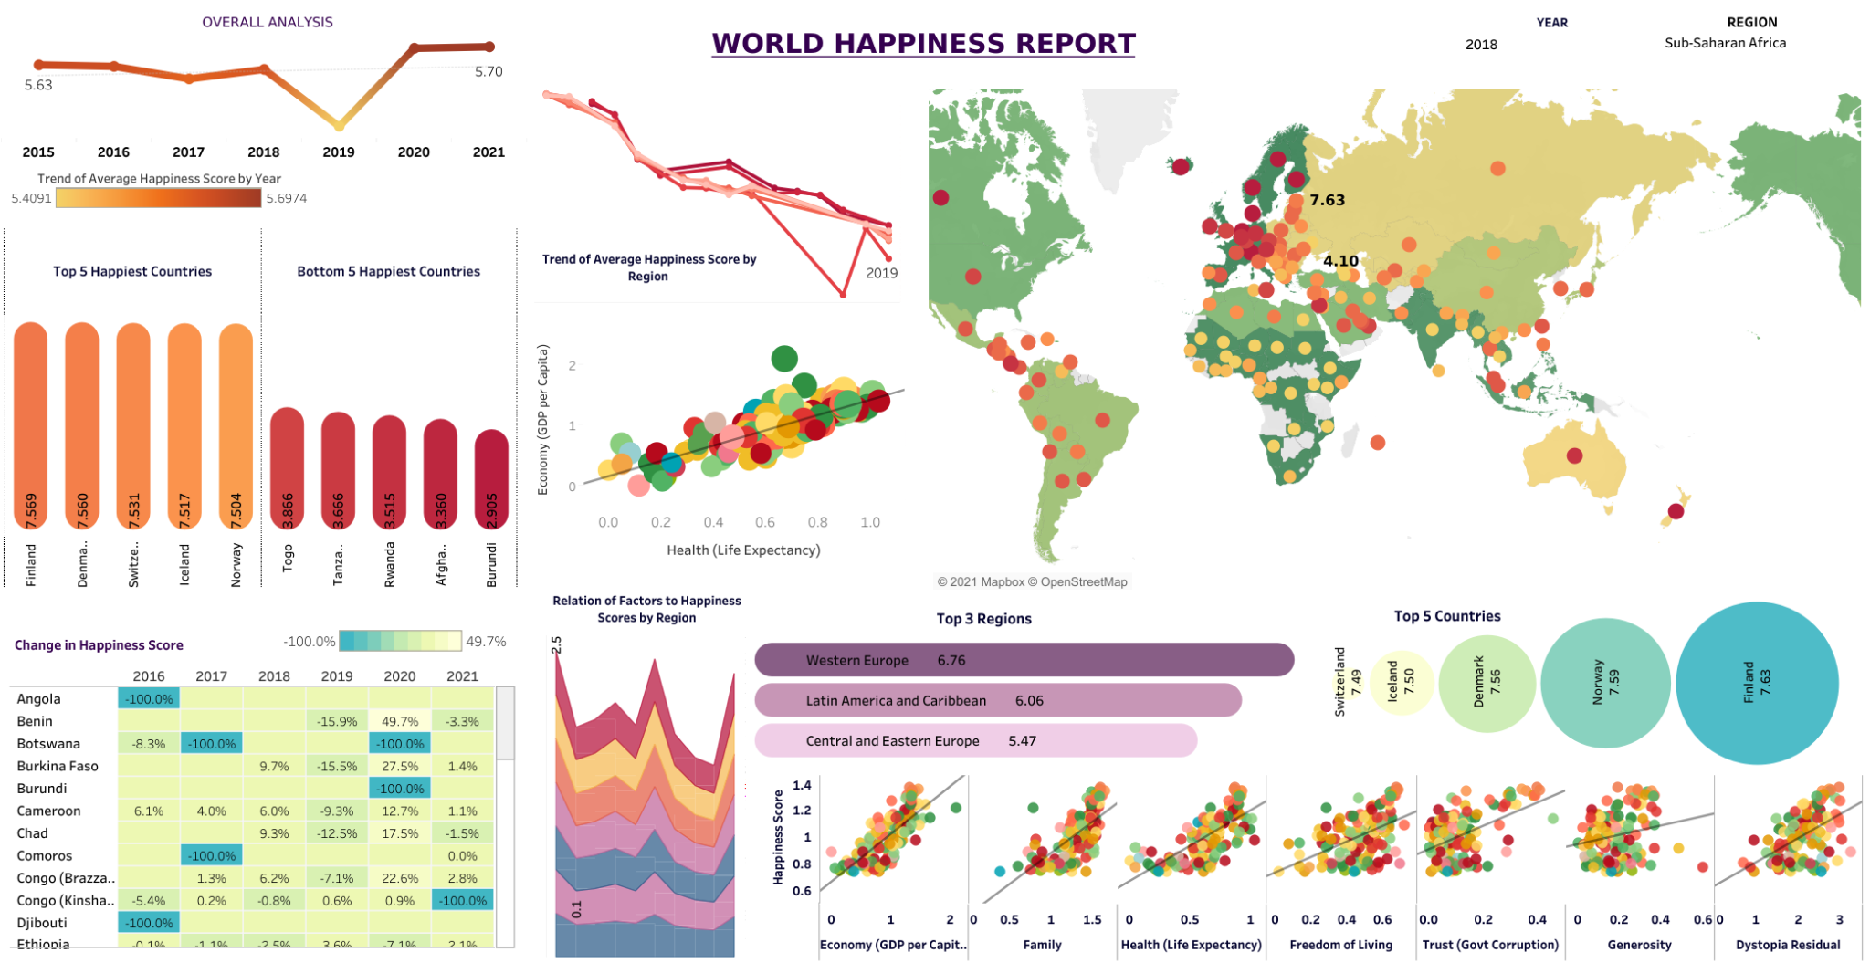

Slide 6
Charts Used
1. Line Chart
2. Bar Graph
3. World Map - Dual Axis
4. Circles
5. Scatter Plot
6. Area Chart
7. Heatmap

